Slide 1
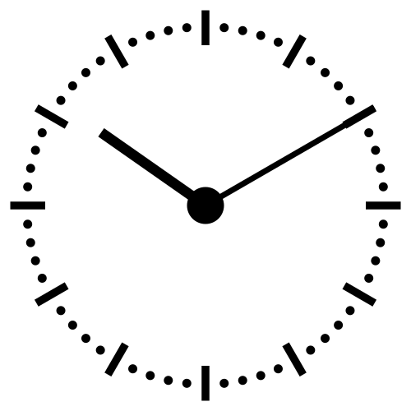
The Fourth Hour!
Welcome to…

Slide 2
Introduction
Welcome to the Fourth Hour!
Name
Professor
A fun fact about you

Slide 3
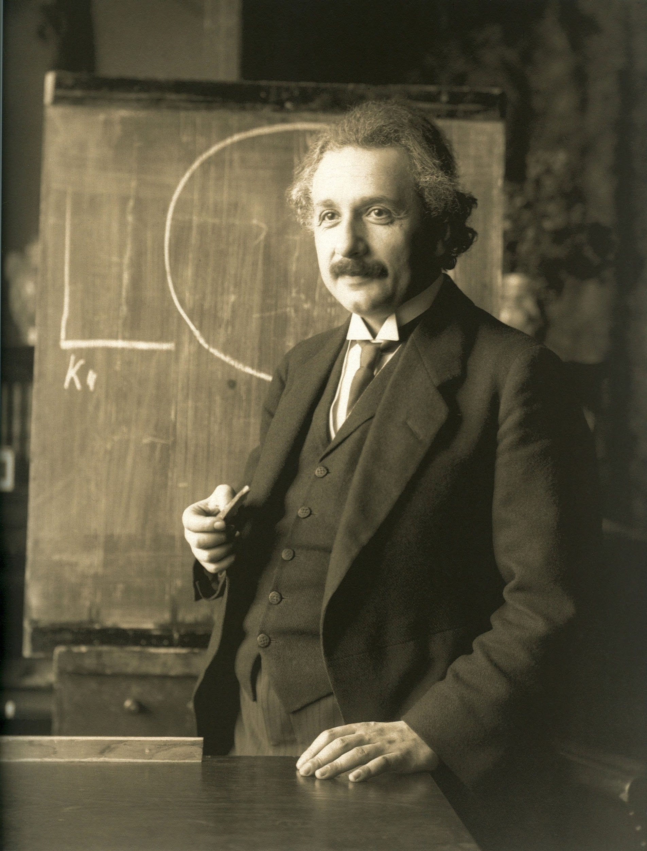
“Anyone who has never made a mistake has never tried anything new.”

Slide 4
What are loops
Loops allow us to perform the same action or similar action over and over again while a certain condition is met.
What kind of loops have we learned so far?
while loops
for loops

Slide 5
while loops
i = 0
while i < 3: print i
i += 1

Slide 6
while loops
Initial value (initializer)
i = 0
while i < 3: print i
i += 1

Slide 7
while loops
Initial value (initializer)
i = 0
while i < 3: print i
i += 1
Condition that must be met

Slide 8
while loops
Initial value (initializer)
i = 0
while i < 3: print i
i += 1
Condition that must be met
Update

Slide 9
for loops
for i in range(1, 3, 1): print(i)

Slide 10
for loops
Starting value
for i in range(1, 3, 1): print(i)

Slide 11
for loops
Starting value
for i in range(1, 3, 1): print(i)
Max value

Slide 12
for loops
Starting value
for i in range(1, 3, 1): print(i)
Update
Max value
1
2
Notes:
EXPLAIN MAX VALUE IS NOT REACHED THIS PRINTS
1
2

Slide 13
for loops
lst = ["test", "hi"]
for i in lst:
print(i)
test
hi

Slide 14
for loops
for i in "String":
print(i)
S
t
r
i
n
g

Slide 15
Review
Login to Socrative at https://b.socrative.com/login/student/
Use code 4thHour149

Slide 16
Question 1 - PI
What is printed by the following code?
val = 0
for i in ‘abc’:
val += 1
print(val)
1
2
3
6

Slide 17
Question 1 - PI
What is printed by the following code?
val = 0
for i in ‘abc’:
val += 1
print(val)
1
2
3
6

Slide 18
Practice 1
Use a for loop to print every odd number 1-10.
Output should be:
1
3
5
7
9
Notes:
for i in range(1, 10, 2):
print(i)

Slide 19
Practice 2
Use a for loop to concatenate all of the numbers 1-5
Output should be:
1
12
123
1234
12345
Notes:
temp = ""
for i in range(1, 6):
temp += str(i)
print(temp)

Slide 20
Question 2 - PI
What is printed by the following code?
val = 0
for i in ‘abc’:
for j in ‘def’:
val += 1
print(val)
1
3
6
9
27

Slide 21
Question 2 - PI
What is printed by the following code?
val = 0
for i in ‘abc’:
for j in ‘def’:
val += 1
print(val)
1
3
6
9
27

Slide 22
Practice 3
Given a list, use a for loop to find the highest and lowest number and print the sum of the two numbers. Note: do NOT use the min or max functions.
nums = [9, 4, 2, 1]
Output should be:
10
Notes:
nums = [9, 4, 2, 1]
min = nums[0]
max = nums[0]
for i in nums :
if i > max:
max = i
if i < min:
min = i
print(min+max)

Slide 23
Practice 4
Using a for loop and an if statement write a function that appends all the elements in a list to a new list unless the element is an empty string: "".
For example:
lst =["Carter", "Maddie", "", "Cory", "", "", "", "Alyssa"]
should print:
['Carter', 'Maddie', 'Cory', 'Alyssa']
Notes:
lst =["Carter", "Maddie", "", "Cory", "", "", "", "Alyssa"]
new_list = []
for i in lst:
if i != "":
new_list.append(i)
print(new_list)

Slide 24
Practice 5
Using a for loop and if statement, count how many times a letter is in a word
For example:
word = “Running”
letter = “n”
Should print:
3
Notes:
word = "Running"
letter = "n"
count = 0
for i in range(len(word)):
if word[i] == letter:
count += 1
print(count)

Slide 25
Question 3
What is printed by the following code?
list1 = [[0, 0, 0], [1, 1, 1], [2, 2, 2]]
for i in range(1, len(list1)):
for j in list1[i]:
print(j, end=” ”)
0 1 2
1 2
0 0 0 1 1 1 2 2 2
1 1 1 2 2 2

Slide 26
Question 3
What is printed by the following code?
list1 = [[0, 0, 0], [1, 1, 1], [2, 2, 2]]
for i in range(1, len(list1)):
for j in list1[i]:
print(j, end=” ”)
0 1 2
1 2
0 0 0 1 1 1 2 2 2
1 1 1 2 2 2

Slide 27
While Loop Practice (From last week)
Notes:
If time permits

Slide 28
Practice 1
Use a while loop to print every odd number 1-10.
Output should be:
1
3
5
7
9
Notes:
i = 1
while i <= 10:
print(i)
i += 2

Slide 29
Practice 2
Write a program that calculates the factorial for a number using a while loop.
5 factorial is 120 → 5 * 4 * 3 * 2 * 1
Notes:
start = 5 # this can be any num
i = 1
temp = 1
while i <= start:
temp *= i
i += 1
print(start, "factorial is", temp)

Slide 30
Practice 3
Using while loop combined with an if statement, iterate through the given list and if there is a 100, print it with its index number.
i.e.: "There is a 100 at index no: 3"
lst=[10, 1, 5, 100, 4]
Notes:
lst=[10, 1, 5, 100, 4]
i = 0
while i < len(lst):
if lst[i] == 100:
print("There is a 100 at index no: " + str(i))
i = i+1

Slide 31
Practice 4
Using while loop and an if statement write a function that appends all the elements in a list to a new list unless the element is an empty string: "".
For example:
lst =["Carter", "Maddie", "", "Cory", "", "", "", "Alyssa"]
should print:
['Carter', 'Maddie', 'Cory', 'Alyssa']
Notes:
lst =["Carter", "Maddie", "", "Cory", "", "", "", "Alyssa"]
i = 0
new_list = []
while i < len(lst):
if lst[i] != "":
new_list.append(lst[i])
i += 1
print(new_list)

Slide 32
Practice 5
Using a while loop and if statement, count how many times a letter is in a word
For example:
word = “Running”
letter = “n”
Should print:
3
Notes:
word = "running"
letter = "n"
i = 0
count = 0
while i < len(word):
if word[i] == letter:
count += 1
i += 1
print(count)

